Slide 1
SCIENCE HAS LEFT THE HOUSE (AND THE SENATE)
Edwina Rogers
Secular Policy Institute

Slide 2
Notes:
Everyone knows that Nancy Reagan had an astrologer. Her name was Joan Quigley.
We’d like to believe that she had no real influence but President Reagan’s Chief of Staff, in his autobiography, wrote “Virtually every major move the Reagans made… was cleared in advance by [Quigley] who drew up horoscopes.”
It’s funny because we know that Republicans have funny beliefs. But what about Democrats?

Slide 3
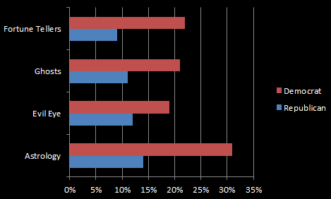
Who Believes It?
Notes:
A Pew Study in 2009 (“Many Americans Mix Multiple Faiths“) found that even more Democrats believe in Fortune Tellers and Astrology. And 36% of Democrats believe they have communicated with the dead, compared to 21% of Repubiclans. But really it is BOTH parties. Everyone has strange beliefs, and this definitely affects Congress and our nation’s laws. And thus it affects YOU.

Slide 4
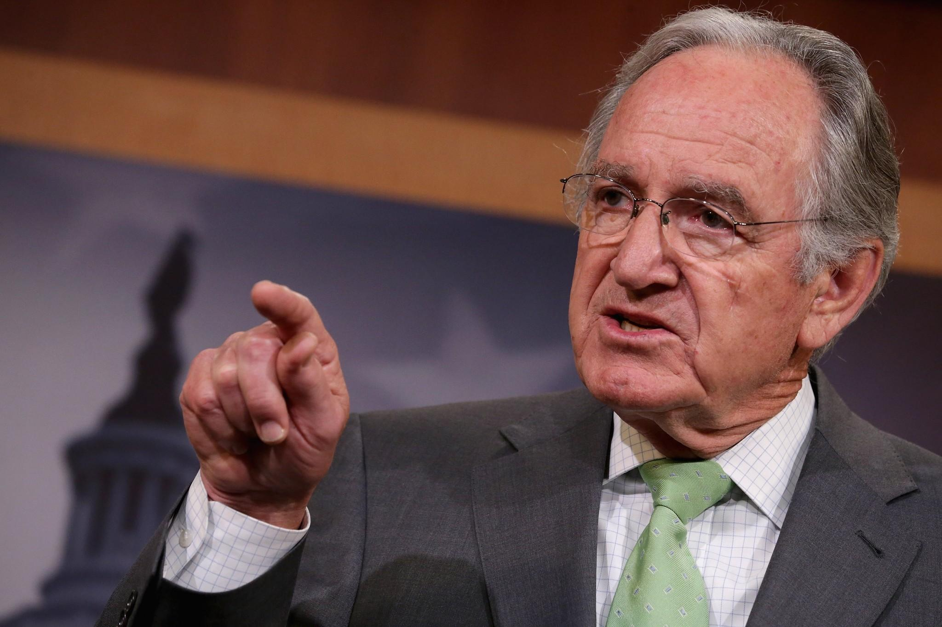
Notes:
This is Senator Tom Harkin, who until he retired this year chaired the Senate subcommittee that funds the National Institutes of Health.
Unfortunately Senator Harkin was an advocate for alternative medicine, and created
He also created the National Center for Complementary and Alternative Medicine, which is a real part of the NIH. It now spends 130 million dollars a year on phony homeopathic treatments such as therapeutic touch for curing bone cancer, and using bee pollen to treat allergies. Harkin personally took up to 60 bee pollen pills a day. He is a Democrat.

Slide 5
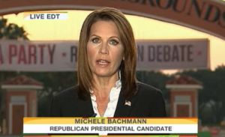
Notes:
This is former Congresswoman and Presidential Candidate Michelle Bachman, saying on NBC’s Today Show that vaccinations cause mental retardation. She of course is a Republican.

Slide 6
Political Fears
Democrats
Nuclear Power
GM Food
Industrial Chemistry
Vaccinations
Republicans
Climate Change
Evolution
Stem Cell Research
Sex Education
Notes:
Half of Republicans believe the early is only 10,000 years old…but so do a third of Democrats.
Democrats don’t like nuclear power, genetically modified foods, and industrial chemistry, even though these technologies have enriched lives and fed millions of people. Republicans don’t like sex education. They seem to be willfully ignoring the evidence that when you don’t teach kids safe sex, their sex isn’t safe. This is why Texas, which bans sex education, has a massive chlamydia outbreak and is the 5th worst US state on teen pregnancy.
Republicans are more likely to oppose science because they fear the Devil. Democrats are more likely to oppose science because they fear corporations.
Either way, it leads to a surprising finding: anti-science attitudes are everywhere.

Slide 7
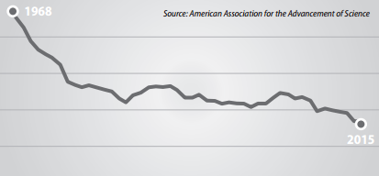
% Federal Budget for R&D
10%
8%
6%
4%
2%
0%
Notes:
Perhaps that’s why the percent of the US federal budget going to research and development is at an all-time low in recent history.

Slide 8
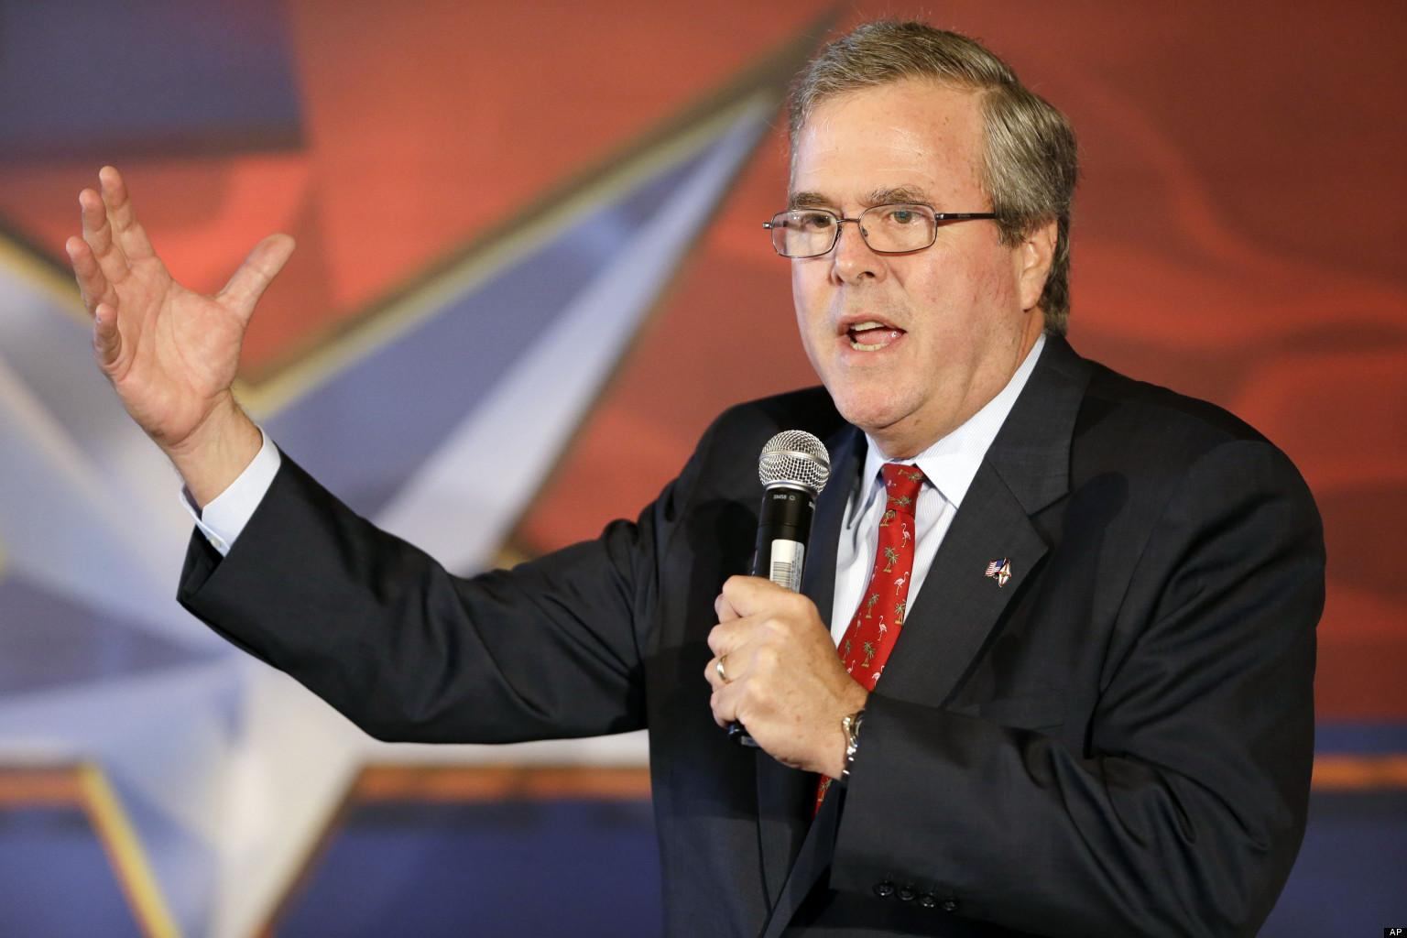
Notes:
Let’s take just one issue. More than 56% of Republicans either deny or question the science behind climate change.
Presidential candidate Jeb Bush acknowledges that climate change exists, but doesn’t think humans have caused it.
And this is something I want you to listen carefully to. If you take away just one thing from this speech, this is it.
In May, just hours after President Obama urged action on climate change, Jeb Bush said, “For the people to say the science is decided on, this is just really arrogant”.

Slide 9
Anti-Science Tactics
“Intellectual arrogance”
“Hear both sides of the issue”
“Not all scientists agree”
“My heart and my faith tell me…”
Notes:
This phrase, intellectual arrogance, is an anti-science tactic. Here are a few phrases to look out for.
Calling scientists arrogant carries the implication that scientists are just asserting their opinions. They’re not. Scientists have facts. Saying we need to hear both sides of the issue implies that all ideas are equally valid and deserve the same amount of attention. They’re not and they don’t. Finding a few scientists who go against the mainstream ignores the fact that a mainstream consensus exists. The scientific consensus is not a popularity contest. It’s okay to follow the scientific consensus because the scientific method has checks and balances, and it comes from real data.
And talking about faith is really no substitute for facts. Isn’t it arrogant to say that what you feel in your heart shapes the whole Universe?

Slide 10
Myths about Science in Politics
It’s basically fine
Maybe the Democrats will fix it
It’s so bad it’s hopeless
Notes:
Let’s talk about science myths in politics. But Don’t Panic. Most of you are probably holding on to a few myths. First, you might think, “Everything is basically okay,” but as we’ve seen today, it isn’t. And then you might think, well, I’ll just vote Democratic and they’ll fix it. But Democrats have their own issues with science. In 2011, President Obama shut down funding for the Tevatron, our nation’s most powerful particle accelerator. He said that the money just wasn’t there, but this was the same year that billions of stimulus dollars got spent on alternative energy loans, many of which like Solyndra went nowhere, when nuclear power is the obvious answer to climate change.
The third stage of grief is to give up. It’s easy to think it’s hopeless. But I have good news. It’s not hopeless, and people like you and me really can make a difference.

Slide 11
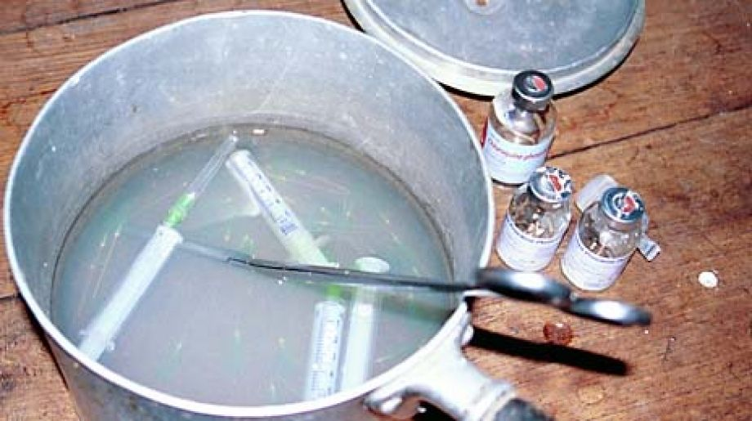
Notes:
I know, because I spent two administrations working in the White House, and worked for four US Senators. A decade ago, I worked for Senator Sessions, a Republican, on the global bill to reduce AIDS in Africa. His original thought was we had to put as much money into abstinence education as possible, but I found something scientific that he could champion. Too many children were getting AIDS because medical syringes were being pulled out of the trash and repackaged. We got the US government to pay for new syringes so that old ones would not be reused.
Here’s a Democratic version of that story that just happened last month.

Slide 12
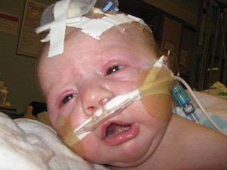
Notes:
This is a baby with whooping cough, a 19th century disease that has been wiped out in the developed world through vaccinations… but only if you actually get your kids vaccinated.
Nearly all US states allow a religious exemption so that if you don’t want your kids to be vaccinated, you don’t have to. This has been especially bad in nutty California, leading to a measles outbreak and the death of 10 infants like this one due to an outbreak of whooping cough with 6,000 cases reported in 2010, and another 3,000 cases just in the first half of 2014.

Slide 13
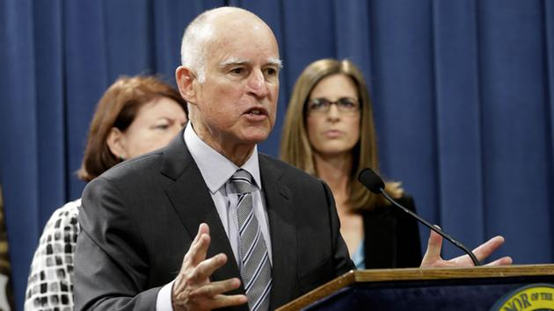
Notes:
So in California, those of us who support science formed a grassroots movement to change the law. On June 30, Governor Jerry Brown signed a new law outlawing a family’s religious and personal beliefs as reasons to exempt schoolchildren from vaccinations. This was a big win for science, and now we can use this law as a model in every other US state across the country. I know that politics seems hopeless and confusing, but politicians listen to voters a lot more than you think. YOU really can make a difference in fighting those who oppose science and educating those who just don’t know enough.

Slide 14
State Anti-Science Legislation
Colorado
Academic Freedom Act (HB13-1089), encourages students to question the validity of evolution and climate change
Alabama
HB 592, gives teachers permission to teach science based on personal beliefs
Arizona
Allows students to be misinformed on “controversial” topics under the guise of critical thinking
Notes:
House Bill 13-1089 was introduced to the Colorado state house of representatives in January of 2013. This legislation would essentially provide academic freedom acts for K-12 as well as institutions of higher learning that would allow instructors to encourage students to question the validity of the theory of evolution and climate change. It would allow for students to be misinformed as to the level of actual scientific controversy regarding the science supporting evolution and climate change. While the bill was never passed, it sheds light on the battle going on in schools across the country. In April 2015, a similar bill was introduced in Alabama. House bill 592 would give teachers permission to teach whatever they believed regarding science in the classroom without the fear of authorities intervening.
A similar bill in Arizona explains the reasoning that is used to support these bills. The proponents of these bills use the argument that science is based on critical thinking, and therefore, it is beneficial for students to question scientific controversies. However, this leads to students being misinformed about what issues are controversial.

Slide 15
Federal Government Funding For Science
16% budget cut proposed for NSF social and geosciences research
2016 Budget only grants .7% increase, less than the suggested 5.2%
Innovation Deficit
Notes:
A congressional spending panel has proposed a budget that would reduce the budget of the National Science Foundation for research in social and geosciences by 16 percent. However, this decrease is tucked into a $51 billion spending bill. The panel has said that the money should only be used for sciences that directly help the country. The bill which has already been approved by the appropriations committee for the 2016 budget only gives $50 million to the NSF which is only a 0.7 increase which falls far short of the 5.2 percent increase suggested by President Obama. The fact that the bill only places value on the hard sciences like engineering biology reflects a misunderstanding as to why fields like behavioral science are so important.
http://www.salon.com/2015/04/27/lack_of_science_funding_is_seriously_threatening_u_s_national_security_according_to_mit_report/
Science funding is at its lowest level since the Second World War. According to researchers at MIT the lack of science funding could result in what they call an “innovation deficit.” Europe landed a space ship on a comet and china invented the world’s fastest super computer. America’s future is threatened because it could fall behind.

Slide 16
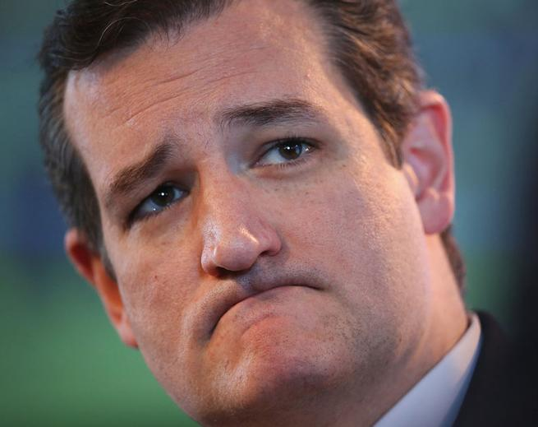
Ted Cruz (R), Chairman of the Senate Subcommittee on Space, Science and Competitiveness
Notes:
“As of January 8, Senator Ted Cruz (R-TX) is now the chairman of the Senate Subcommittee on Space, Science and Competitiveness for the 114th Congress. This will allow Cruz to regulate funding for NASA and other science programs. This news is particularly disturbing given the Senator’s appalling track record when it comes to NASA and science.”
Cruz’s antics caused the 16 day shutdown of the government. This significantly hurt data collection for NASA in all areas from space, to diseases, to food safety. He also opposes climate change which 97 percent of scientists believe to be true.

Slide 17
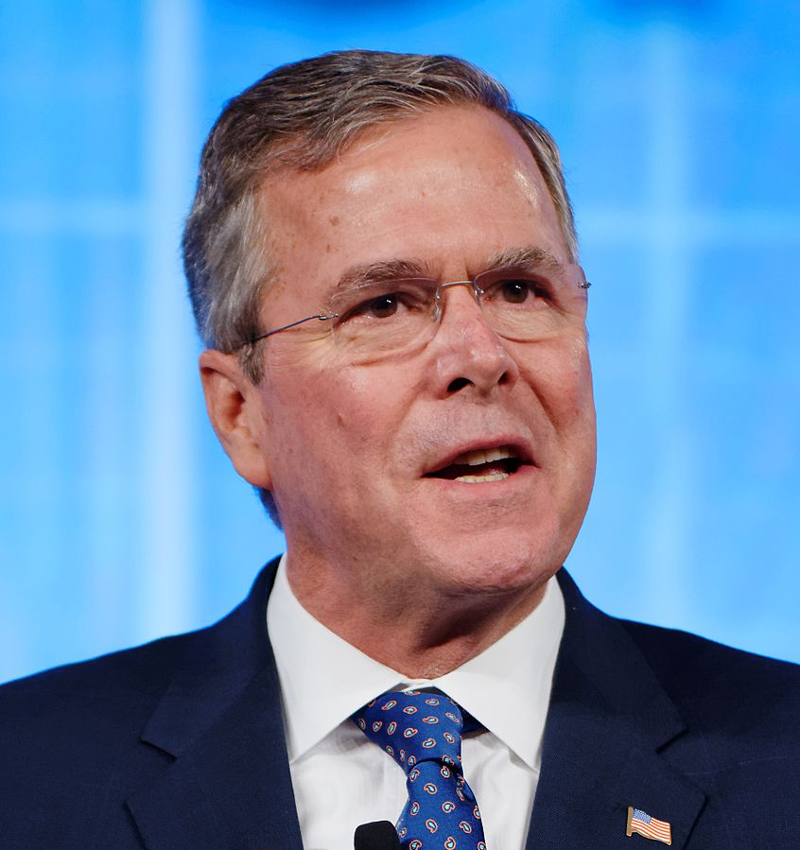
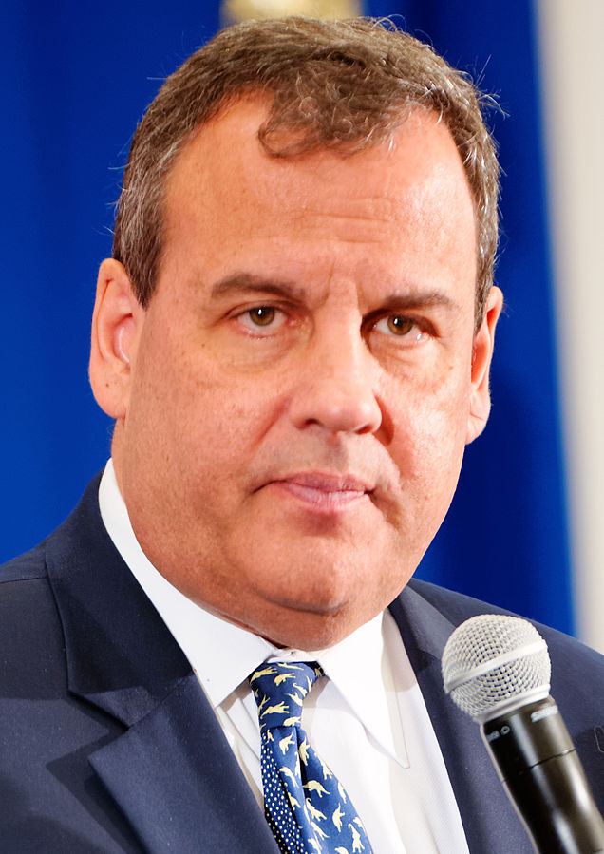
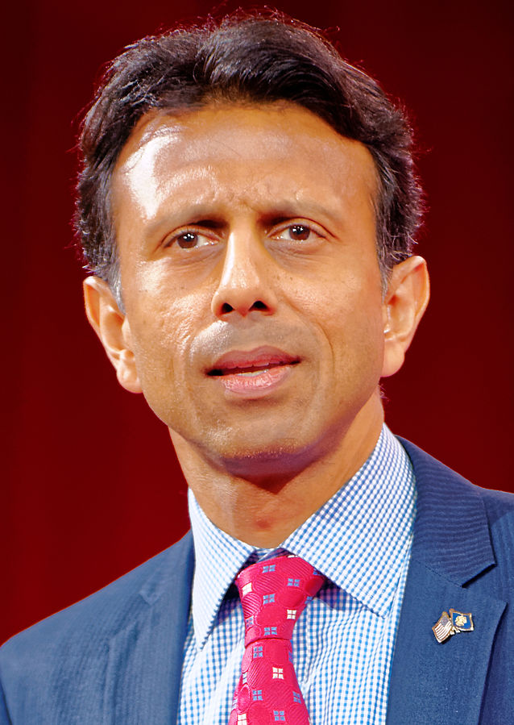
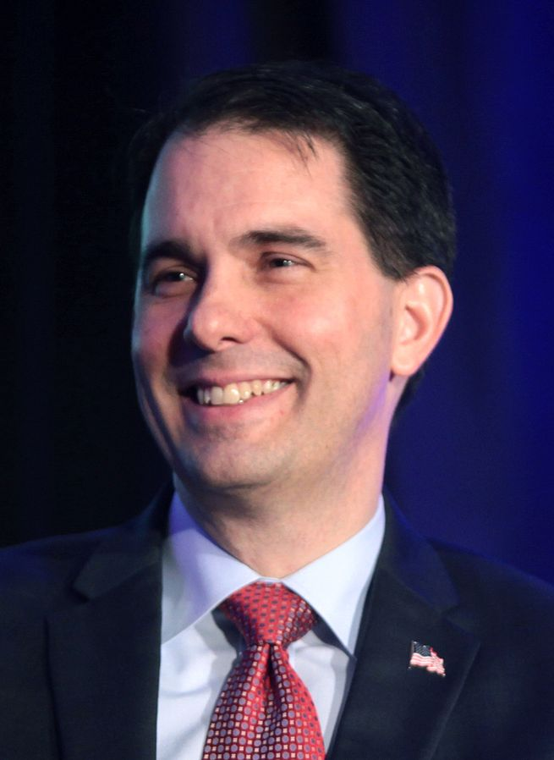
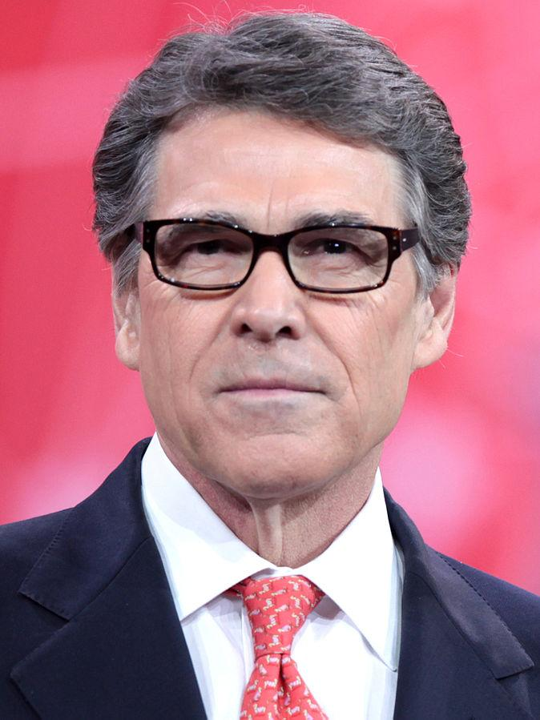
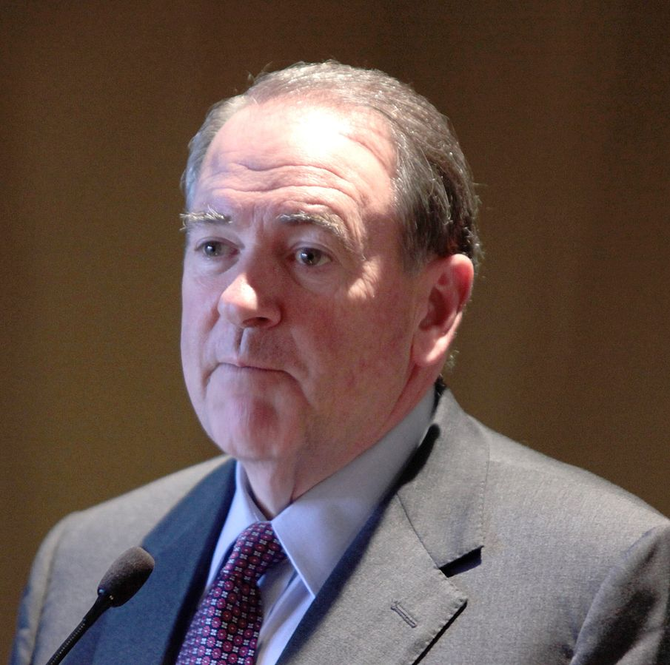
Republican Presidential Candidates
Notes:
“A large number of major party contenders for political office this year took anti-science positions against evolution, human-induced climate change, vaccines, stem cell research, and more.
Such positions are surprising because the economy is such a big factor in this election, and half the economic growth since World War II can be traced to innovations in science and technology.
Partisans at both ends of the political spectrum have been guilty of science denialism. But the Republican version is particularly dangerous because it attacks the validity of science itself.
U.S. voters must push candidates and elected officials to express their views on the major science questions facing the nation or risk losing out to those countries with reality-based policies.”
https://www.scientificamerican.com/article/antiscience-beliefs-jeopardize-us-democracy/

Slide 18
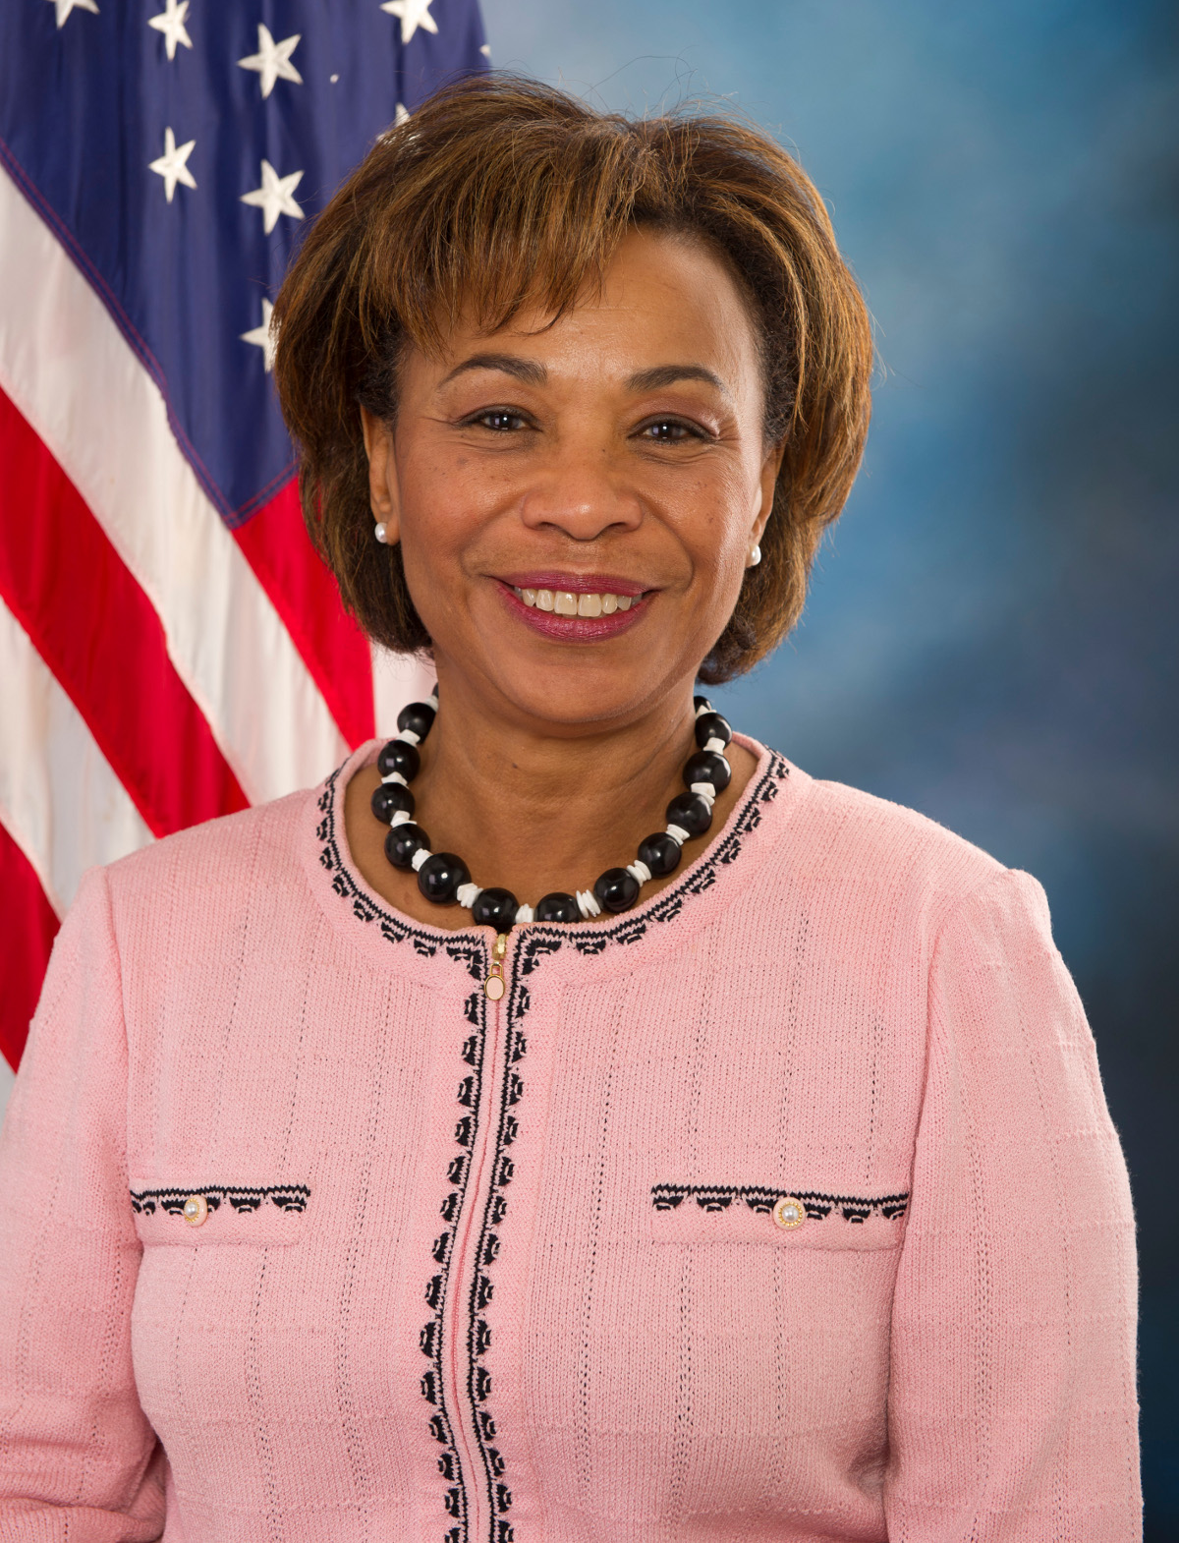
Sex Education
Congresswoman Barbara Lee (D-CA-31)
Notes:
“Congresswoman Barbara Lee (D-CA-31) has once again introduced the Real Education for Healthy Youth Act of 2015, HR 1706 (REHYA), a bill that would provide comprehensive sexuality education for youth and young adults and includes funding for teacher training in sexuality education.”
In California, it was ruled that an abstinence only sex education program violated state law. This is because this is medically inaccurate. California is 1 of only thirteen states that requires medically accurate sex education.
There is no federal mandate that requires sex education so it is left up to the states which leave it up to school districts which leave it up to individual schools. As a result there are many different and conflicting laws.

Slide 19
www.SecularPolicyInstitute.net
Notes:
Challenging politicians on skeptic issues is a core issue at the Secular Policy Institute, the non-profit organization that I run. We use the word “secular” instead of “atheist” because we’re not all atheists. We’re people who believe in a secular society, in separation of church and state, and that government decisions should be made based on reason and science.

Slide 20
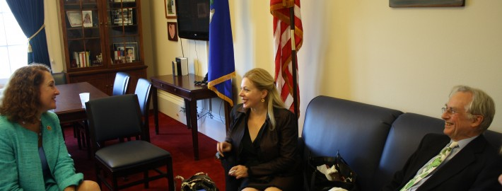
Notes:
For example, here I am with Richard Dawkins bringing reason and science directly to members of Congress through private meetings in their offices and through a congressional briefing.

Slide 21
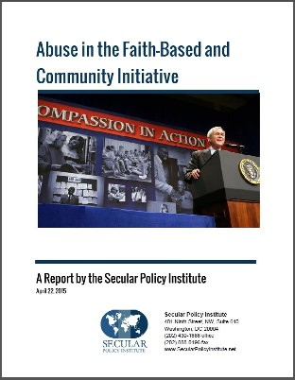
Notes:
We also produce reports such as the Secular Resource Guide, which proves that secular people and skeptics form a large voting bloc, so politicians should listen to us. And the Secular Policy Guide, which tells politicians how science informs policy decisions. We’ve also exposed fraud in the faith-based initiative, where religious organizations get paid to provide services like sex education, which they don’t really get and perform poorly at.

Slide 22
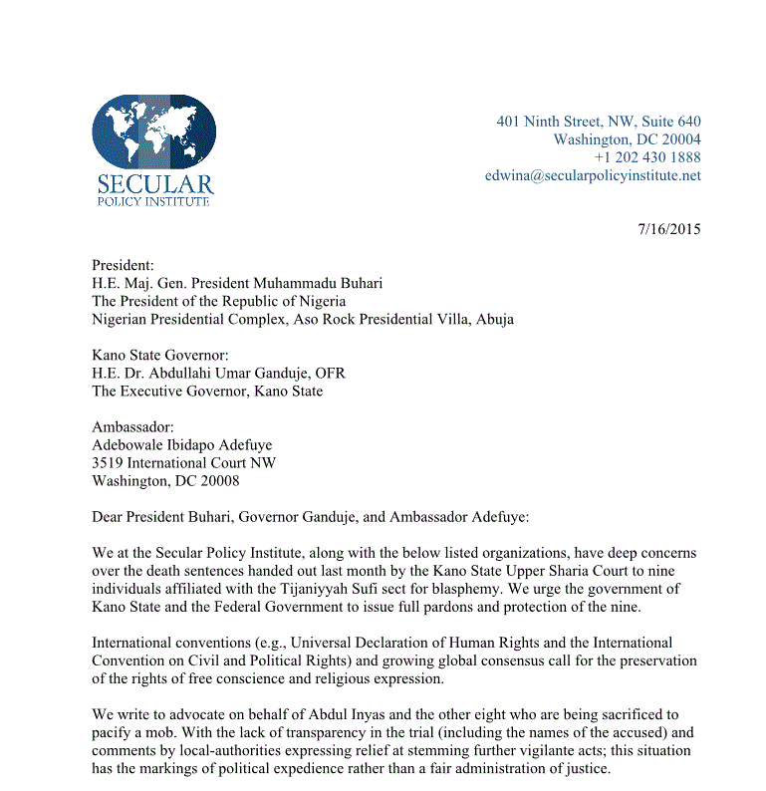
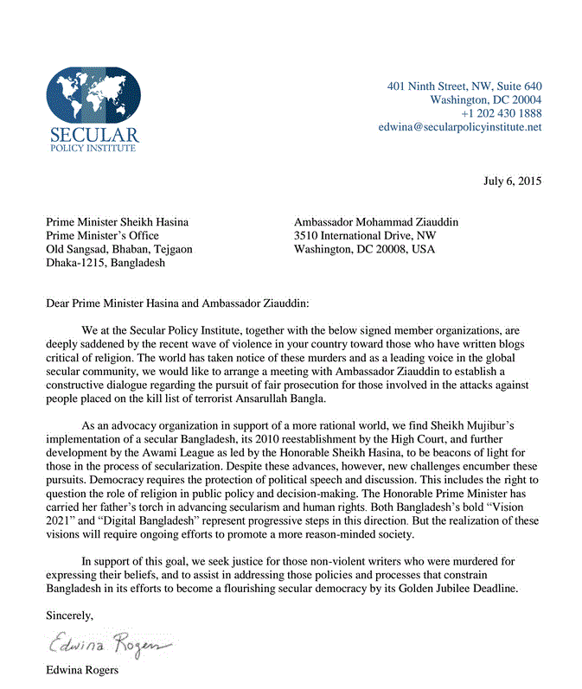
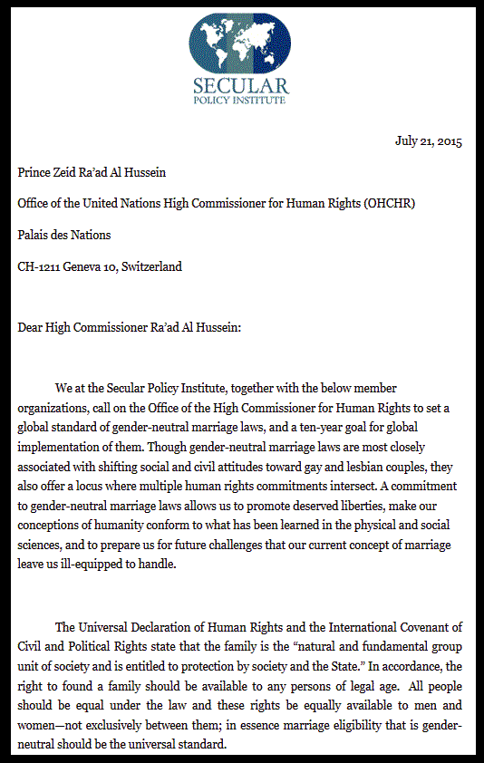

Slide 23
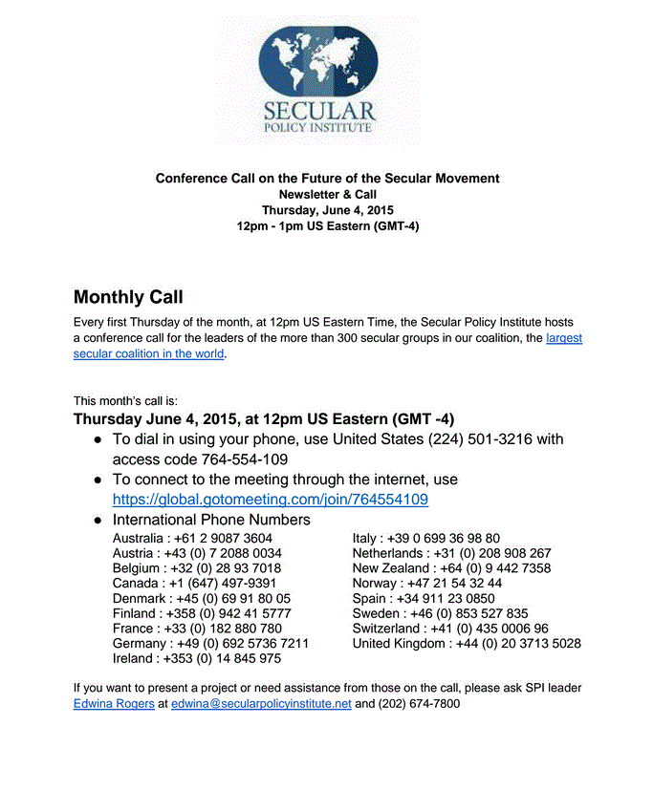
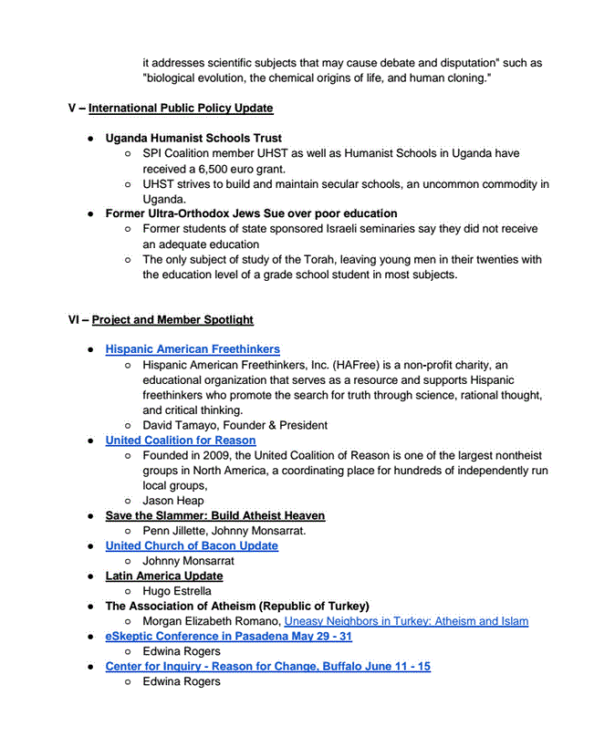

Slide 24
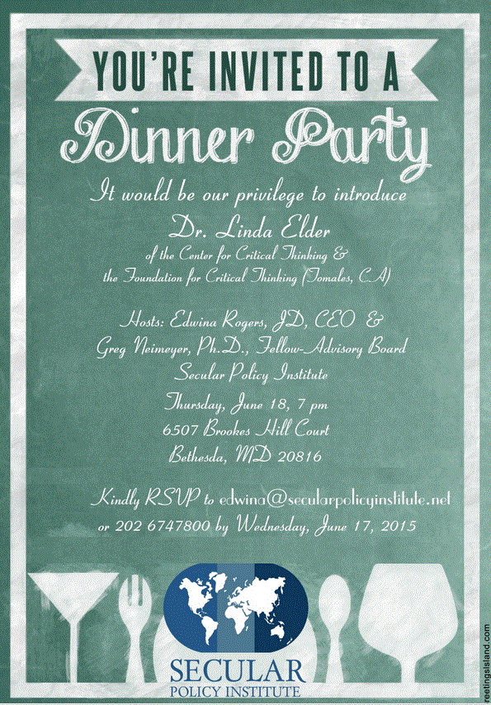

Slide 25
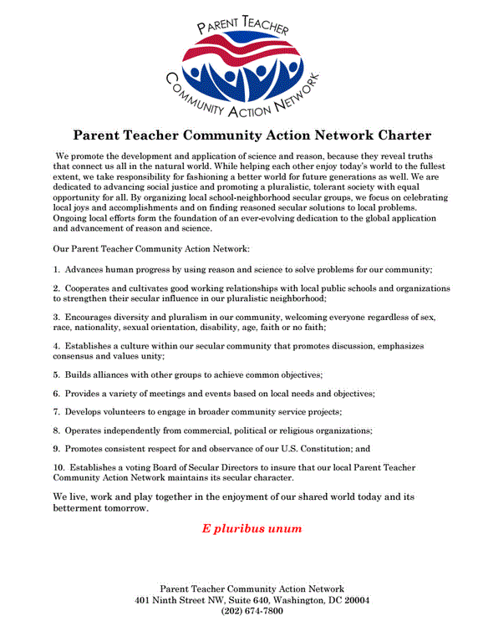

Slide 26
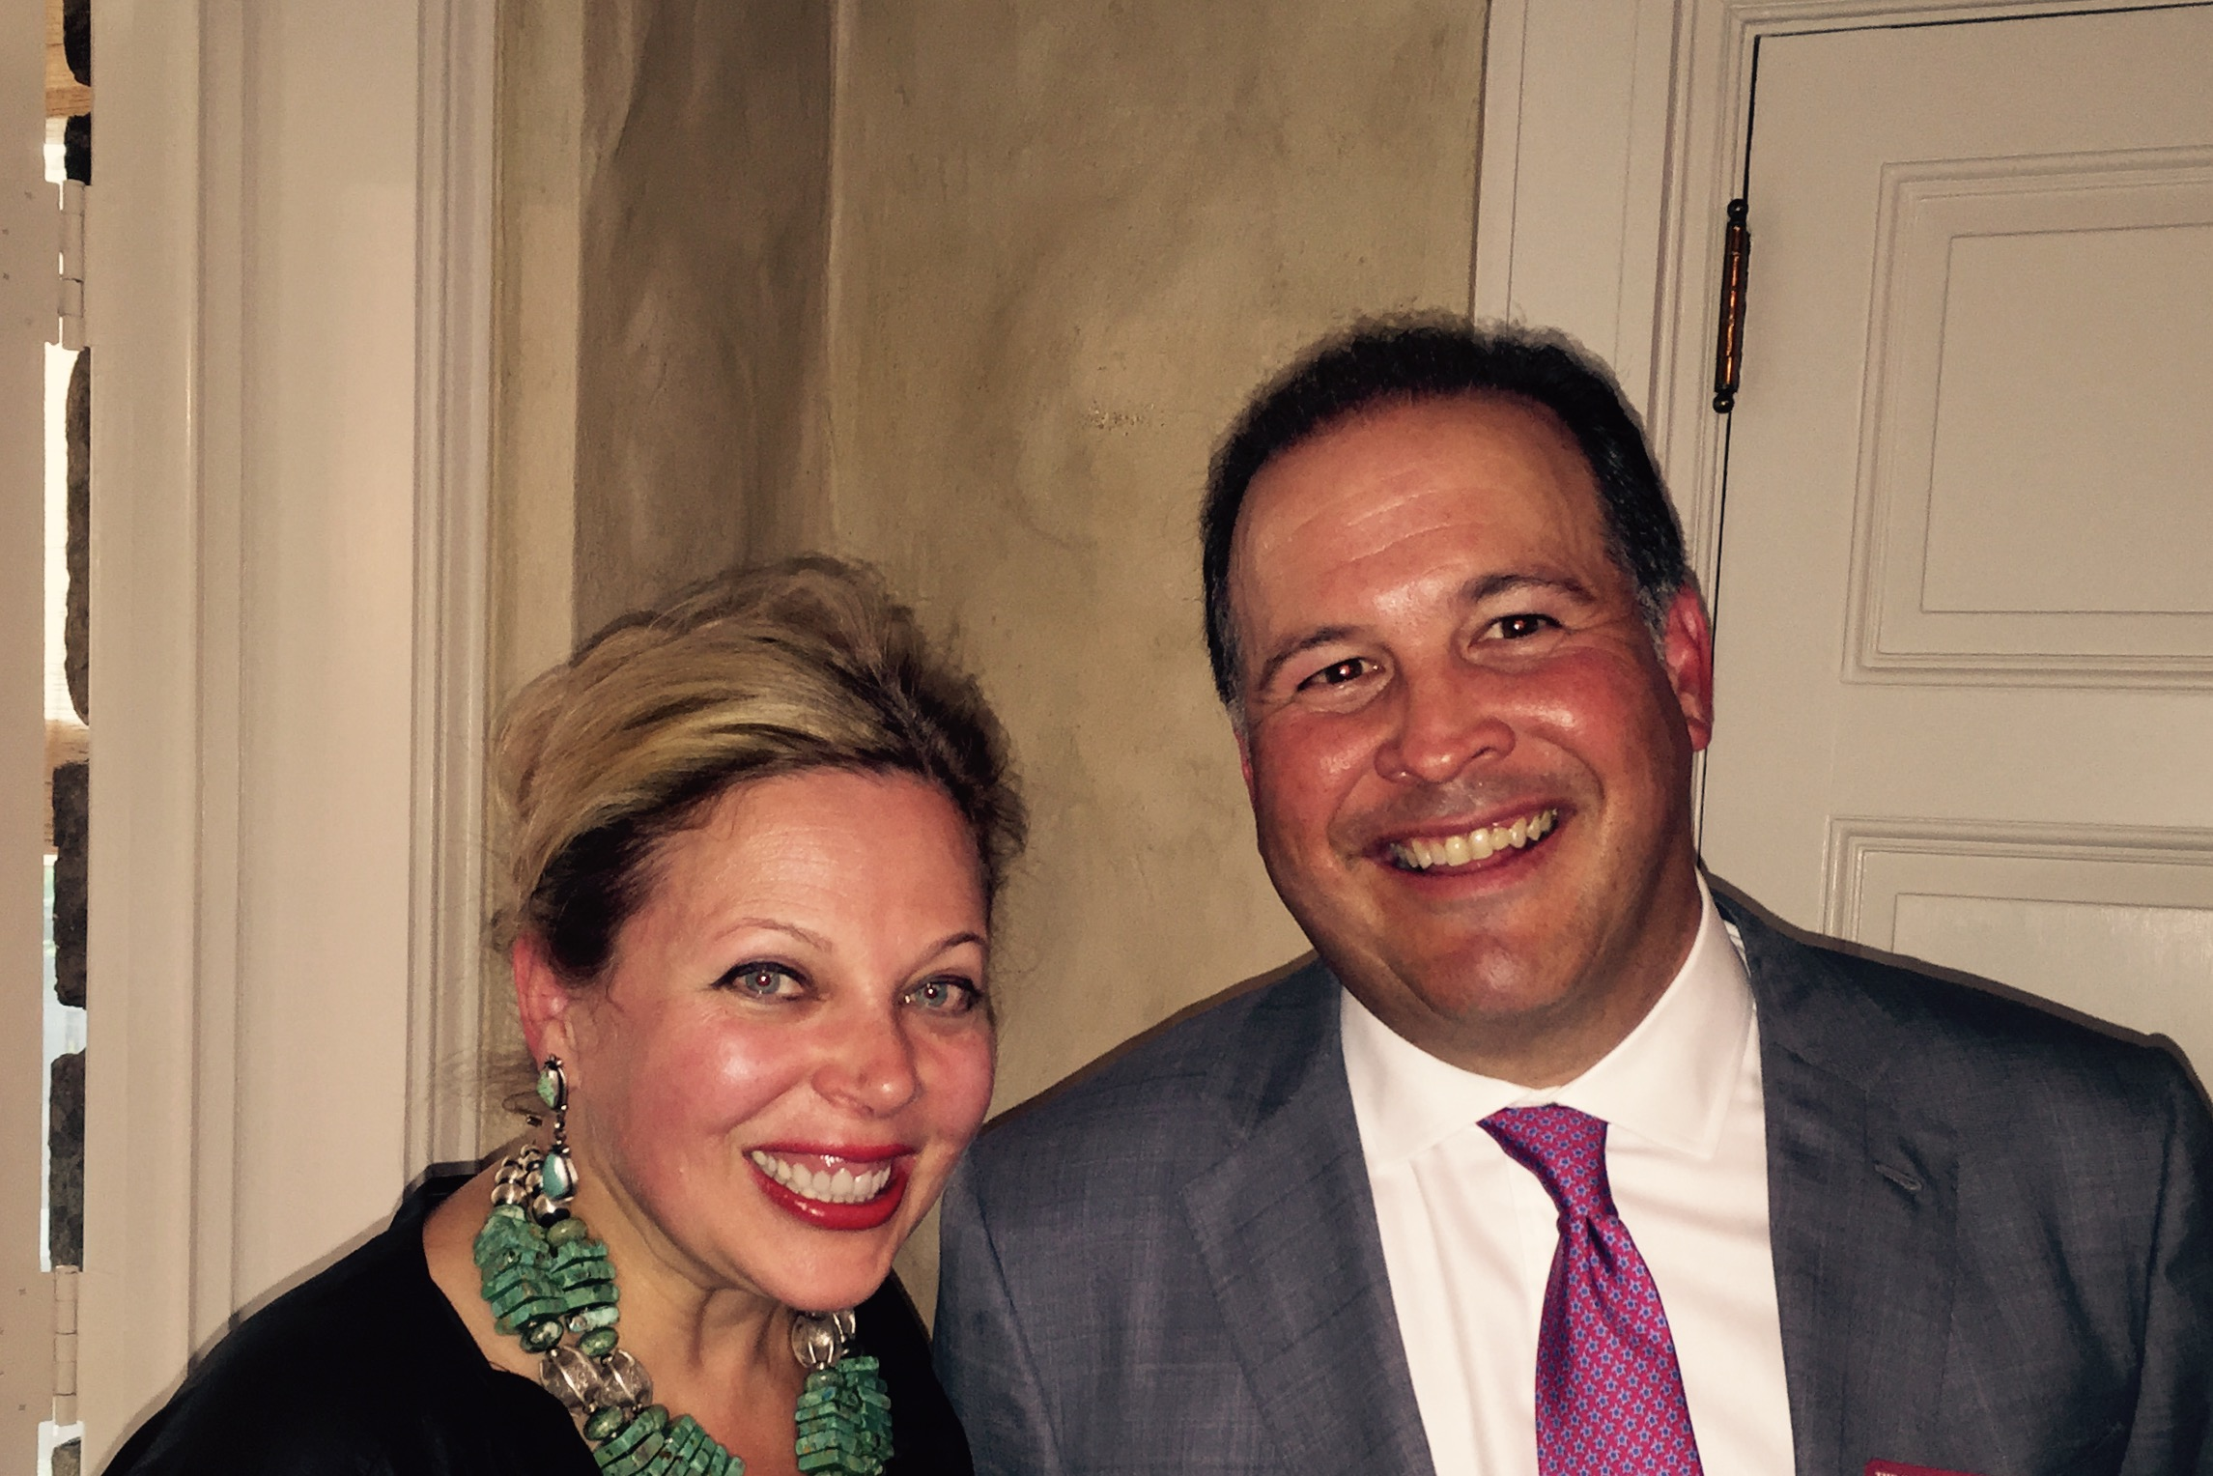

Slide 27
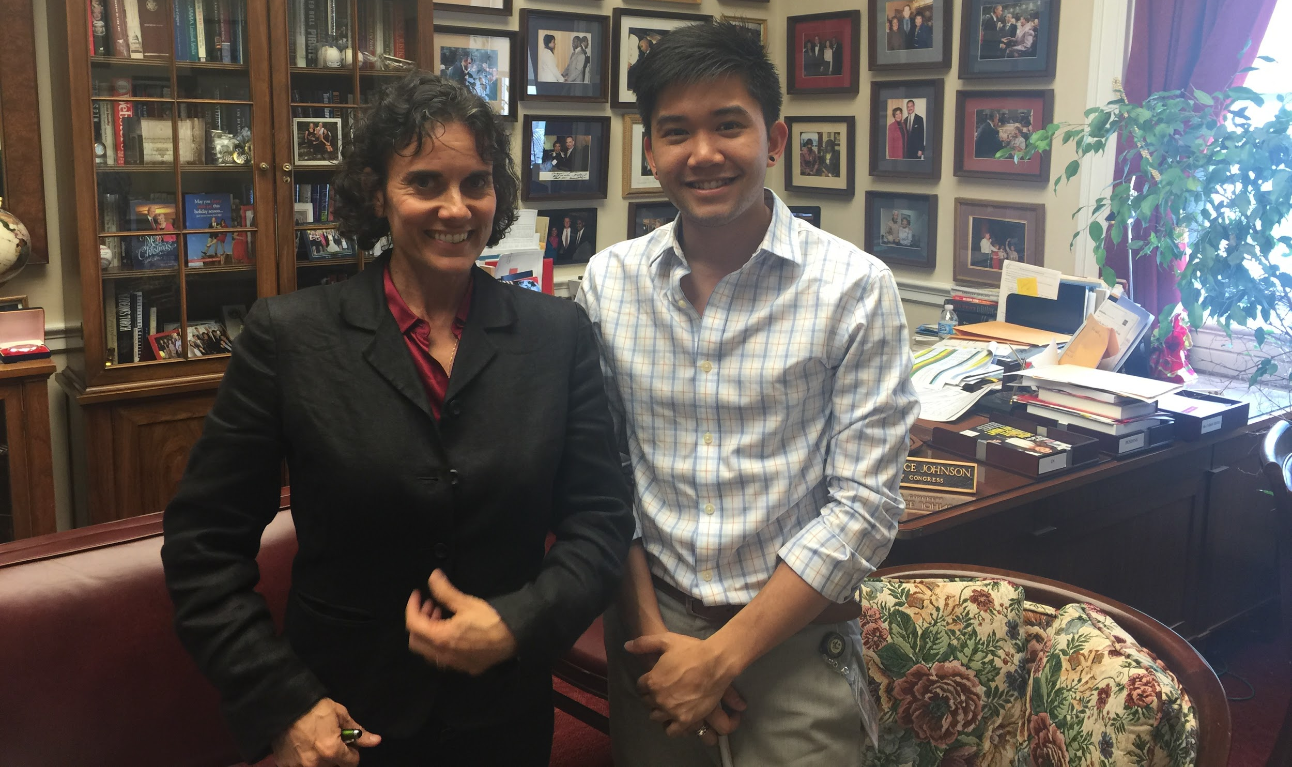
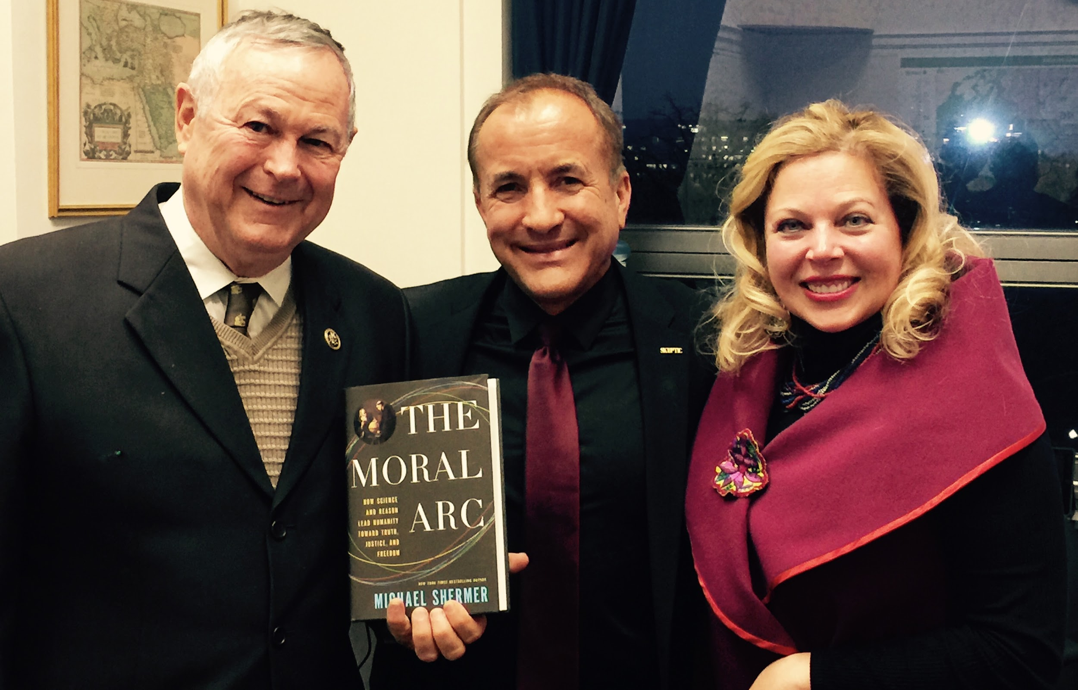

Slide 28
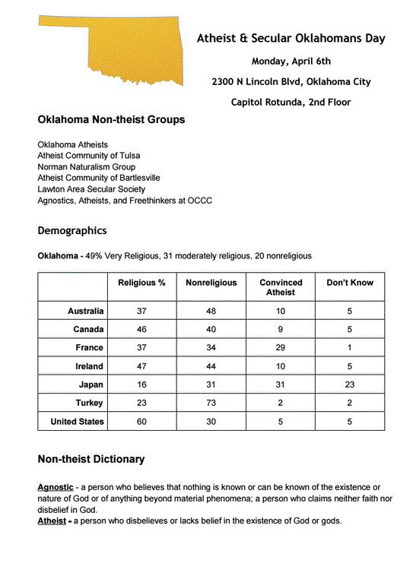
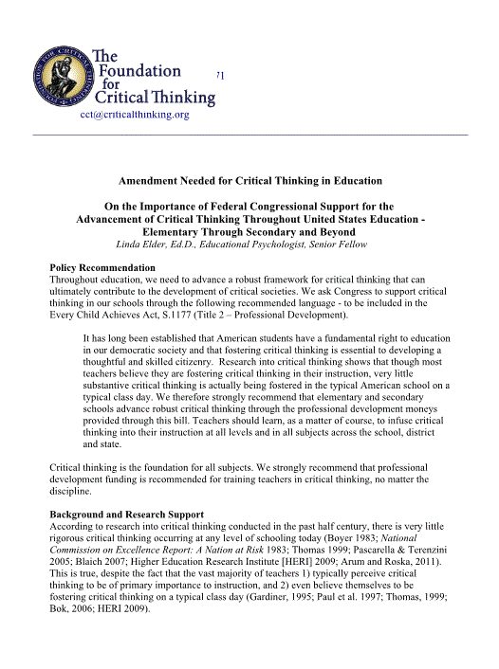

Slide 29
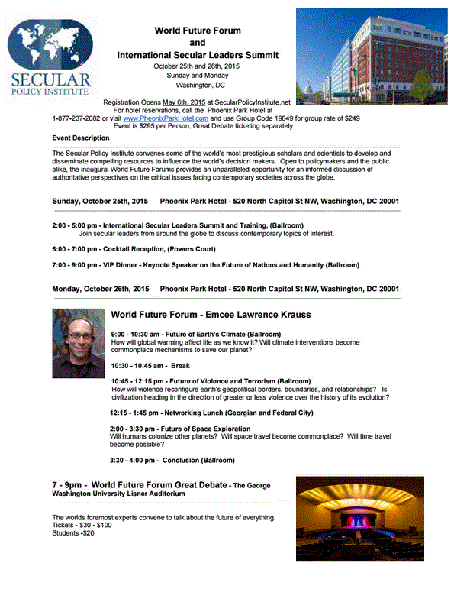

Slide 30
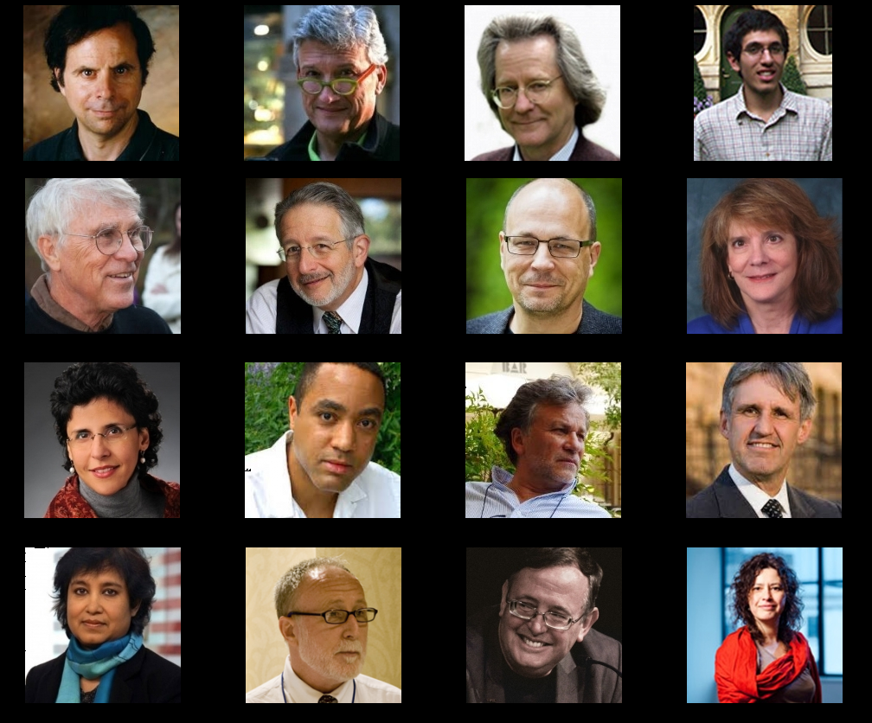
Notes:
The Secular Policy Institute is also the world’s largest coalition of secular organizations, with more than 300 groups representing millions of people in the United States and around the world. We also have the largest and most prestigious secular think tank in the world.
[ If you have time, talk about some of the fellows, their work and specifically how we help them and take partial credit for their successes. ]

Slide 31
Large International Coalition
6384 Groups
300 Coalition Members

Slide 32
Science Has Left The House (And The Senate)
Edwina Rogers
Secular Policy Institute
www.secularpolicyinstitute.net
Cell 202 674-7800
edwina@secularpolicyinstitute.net
Notes:
So I invite you to get involved, so visit SecularPolicyInstitute.net and sign up for our newsletter and read through some of the amazing resources and policy papers that we’ve collected. Together we’re going to score big wins for science with both Republicans and Democrats. Thank you.

